Slide 1
Final Year Design Project Final Defense
Deep Dive
Estimating
Fish Biomass
Using Monocular Unconstrained Underwater Videos
Advisor: Dr. Ahmed Salman Co-Advisor: Dr. Hafsa Iqbal
Team Members:
Usman Jalil 346172 Syed M. Abubakar 337385
M. Saad 333414

Slide 2

Introduction
01
02
03
04
Ecosystem Monitoring and Conservation
Efficient Fisheries Management
Scientific Advancement
Environmental Impact Assessment

Slide 3
Problem Statement
Problem
The challenge at hand is to develop a robust and accurate methodology for estimating the biomass of freely swimming fish from underwater video footage. This involves addressing the complexities of fish detection, classification, tracking, and analysis in an underwater environment. To achieve this, we will leverage state-of-the-art CNNs, Gaussian Mixture Models, and encode-decoder architectures, ultimately contributing to the advancement of ecological research and fisheries management.

Slide 4
Value Proposition
Our research project employs cutting-edge CNNs, Gaussian Mixture Models, and encode-decoder architectures to revolutionize fish biomass estimation in marine biology and environmental conservation. Our non-invasive method offers high accuracy, reducing the need for harmful sampling.
01
02
03
04
Cutting Edge Biomass Estimation
Accurate and more invasive analysis
Publication potential
Environmental Effect

Slide 5

Literature Review
Goal | Year/Author | Research Paper | Method Used
Detection | 2019 Salman et. al. | Automatic fish detection in underwater videos by a deep neural network-based hybrid motion learning system | DNN, GMM, Optical Flow, R-CNN
Classification | 2020 Jalal et. al. | Fish detection and species classification in underwater environments using deep learning with temporal information | Optical Flow, GMM, YOLO
Tracking | 2022 Saleh et. al. | Unsupervised fish trajectory tracking and segmentation | Optical Flow, unsupervised historical moving averages (MVA), Segmenting Objects by Locations (SoloV2)
Depth Estimation | 2020 Ranftl et. al. | Towards Robust Monocular Depth Estimation: Mixing Datasets for Zero-shot Cross-dataset Transfer | Scale and Shift invariant losses
Biomass Calculation | 2020 Li et. al. | Nonintrusive methods for biomass estimation in aquaculture | eDNA methods, Acoustic methods, Machine Vision using IR light

Slide 6

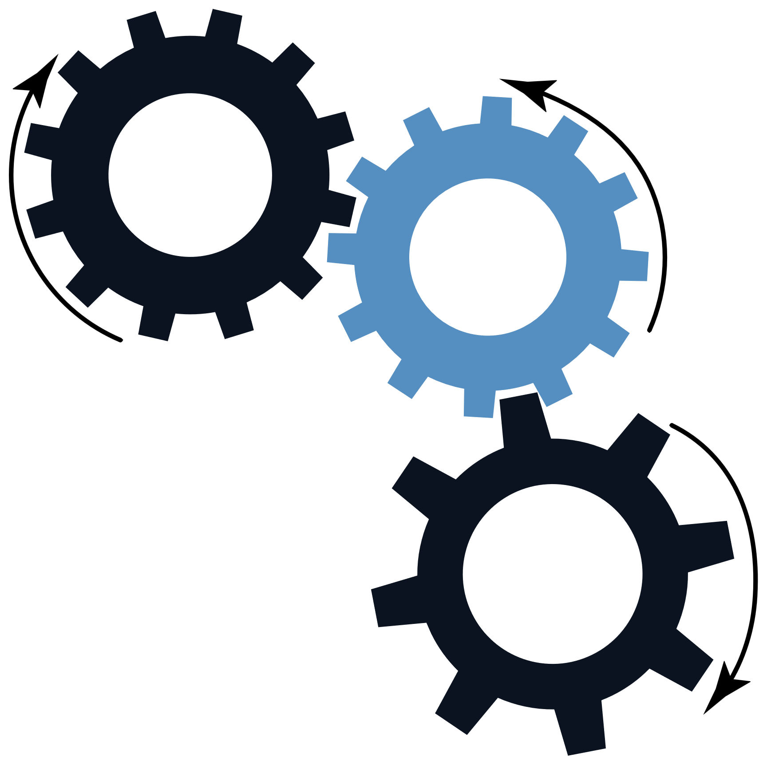
Objectives
1. Develop robust method for accurate fish biomass estimation from underwater videos.
2. Apply advanced techniques: CNNs, GMMs and computer vision approaches.
3. Enhance methodologies for fish classification, tracking, and analysis in challenging underwater conditions.

Slide 7

Fish Detection, Classification & Tracking

Slide 8
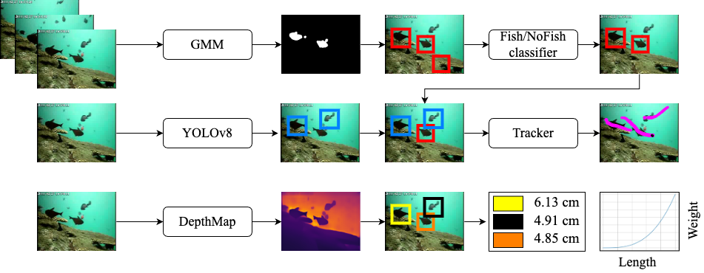
Block Diagram

Slide 9
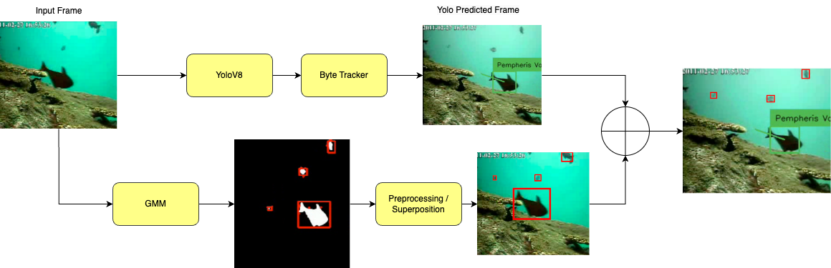
Detection Pipeline
Detection Along with Tracking of Detected Specie to avoid deterrance in Biomass Calculations
Cross Checking Yolo and GMM Detections using IOU to retain only those fish detections of GMM which were missed by Yolo

Slide 10
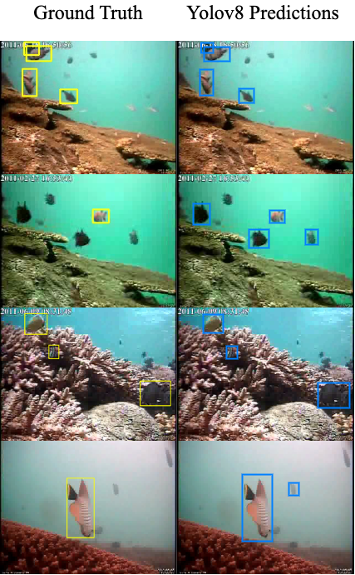

Slide 11
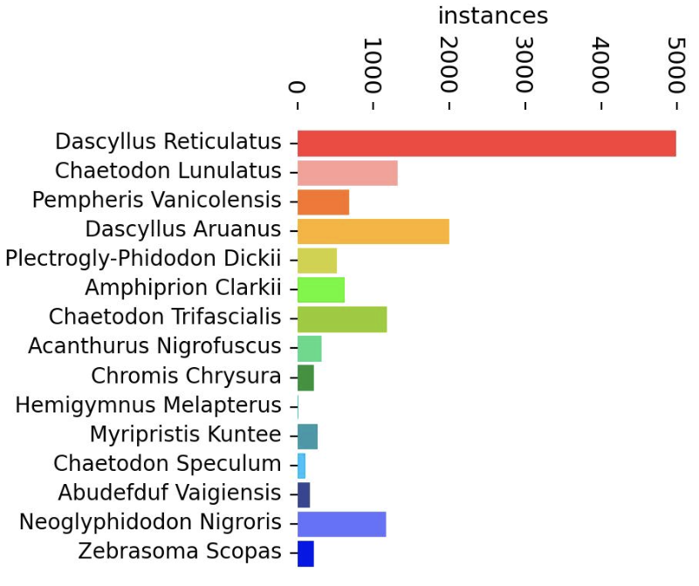
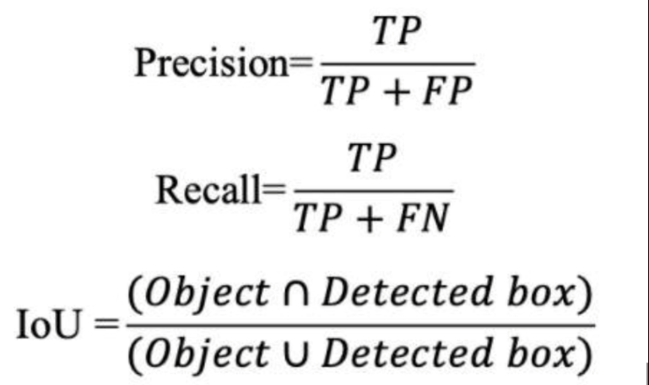
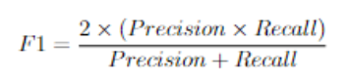
Results Comparison
Class Distribution
F1 score on LifeClef15
Optical Flow + ResNet-50 | 55.7%
SSD+ ResNet | 74.3%
GoogleNet | 83.8%
Yolov3 | 91.5%
Optical Flow + R-50 + Yolov3 | 95.2%
Ours (YoloV8 + GMM) | 97.5%

Slide 12
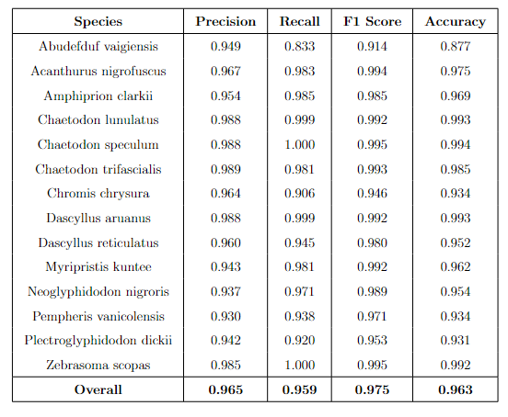
Results

Slide 13
Depth Calculations & Biomass Estimation

Slide 14
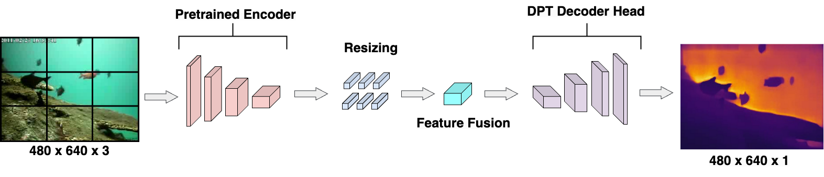
Pipeline for Depth Estimation

Slide 15
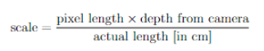
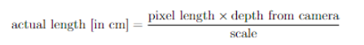
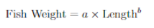
Calculating Length
Linear Scale developed assuming the length of 1 fish from the data to be average.
Once we know the scale, we can just make the actual length the subject and calculate it.
Mass Calculations
A and b parameters depend on the specie of each fish. We took a and b from fishbase website (calculated through regression)

Slide 16
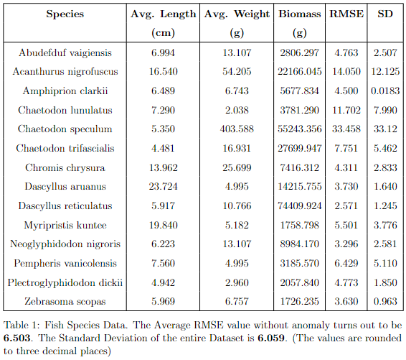
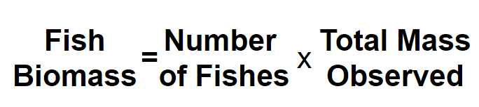
Biomass Estimation

Slide 17
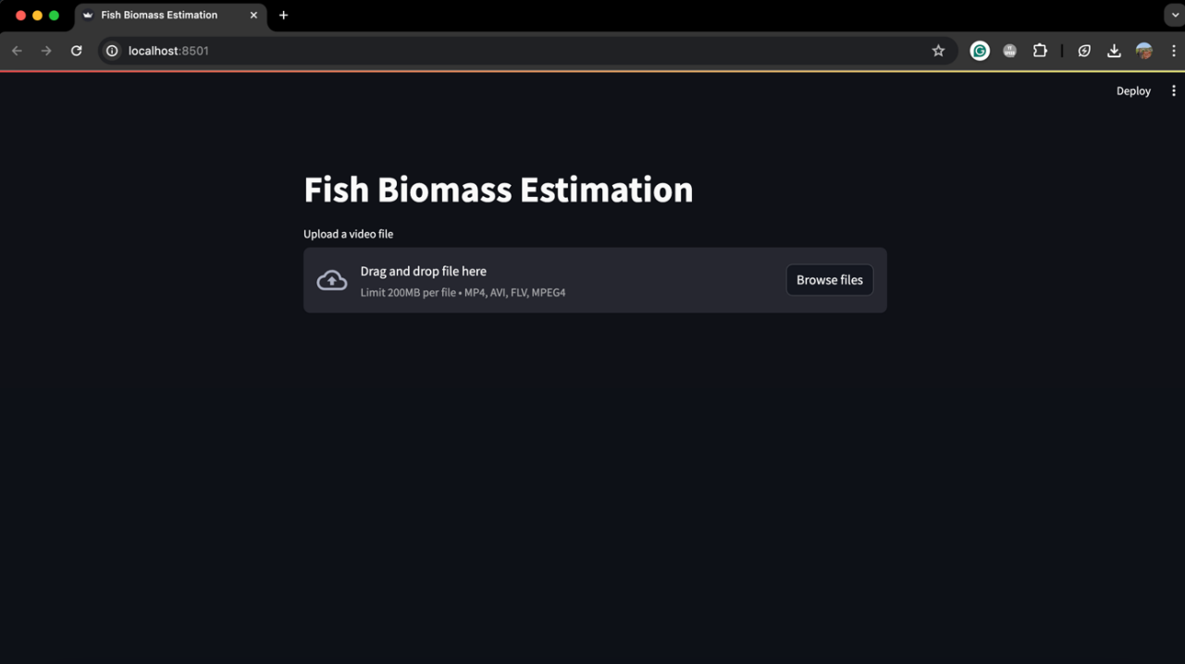
Implementation

Slide 18
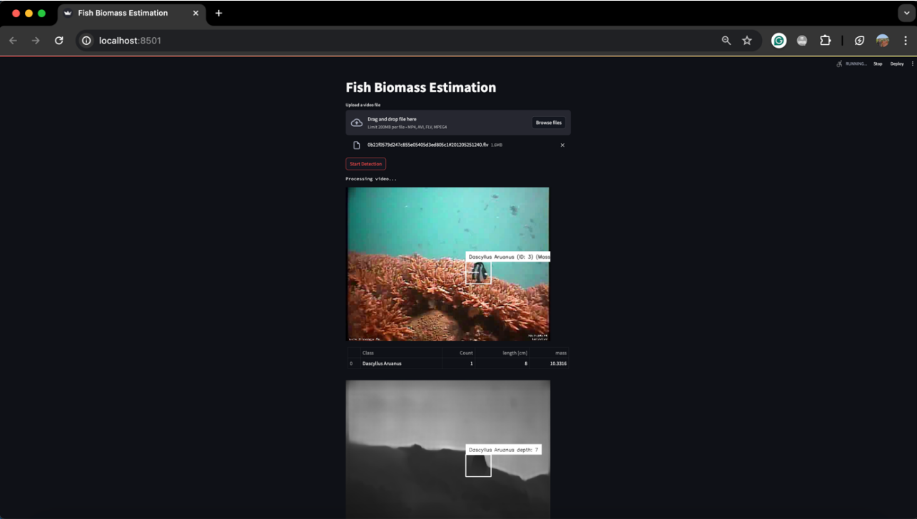
Implementation

Slide 19
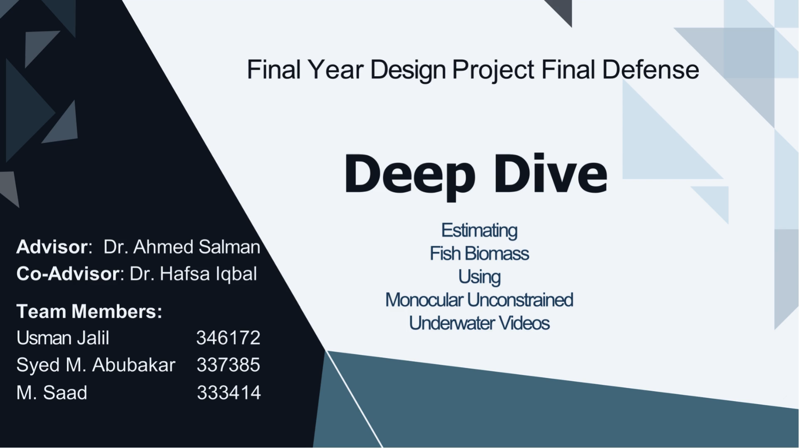
Implementation

Slide 20
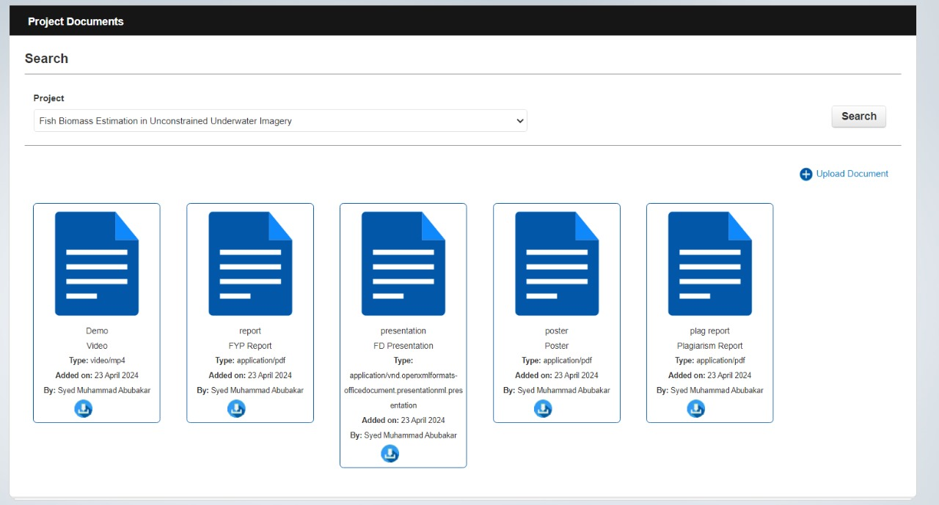
Deliverables Upload Status
Final Report ☑️
Final Presentation Slides ☑️
Poster (A1 size) ☑️
Plagiarism Report ☑️
Demo Video ☑️

Slide 21
Conclusion
Impact: Successful implementation of the project can significantly enhance the monitoring and assessment of fish stocks, enabling better decision-making by fisheries managers.
Grant: Securing the Australian Government grant at the Machine Vision Group, University of Western Australia, Perth, demonstrates recognition and support for the project's importance.
Real-time Biomass Estimation: The project will culminate in the presentation of a real-time biomass estimation system, showcasing the relevance and significance of the research in addressing critical environmental and economic challenges within the fishing industry.

Slide 22

Thank You
For Your Attention
Any Questions?

